Slide 1
Chapter 1: Overview of the Meetings Profession
B.J. Reed, EdD, CMP
Lynn R. Reed, MSPM

Slide 2
Main Topics
Meetings Placed in Context
Meetings Managed by Professionals and Volunteers
Meetings Served by Multiple Entities
Meetings Guided by Multiple Stakeholders

Slide 3
Meetings Placed in Context
Meetings Profession– a complex sector in most economies throughout the world.
Has a long history, but has been recognized as a significant economic contributor for mere decades
Convention Industry Council (CIC) facilitates the exchange of information within the meetings, events, tradeshows, etc. industry
Houses 33 member organization

Slide 4
The Facts
CIC conducted an economic survey in 2012
“2012 Economic Significance Survey”
The study showed:
$280B in direct spending
1.78M U.S. jobs
$115B contribution to GDP
$28B in federal, state, and local tax revenue
$66.8B in U.S. labor income

Slide 5
Professional Convention Management Association (PCMA)
One of the oldest professional development associations in the Meeting/Events industry
Held its first meeting in 1956
In 2013 it realized a year-over-year 9% increase in professional planner participation with final attendance at 3,751
Convening Leaders generated over $2.3M in gross revenues in 2013

Slide 6
Defining the Meetings Profession
Includes large gathering of people for business, sports, or entertainment.
Coalition of representatives formed CIC in 1949 and created:
APEX—industry specific glossary
Templates for common tools
Standards for professional behavior
All compiled in a free online document “CMP International Standard”

Slide 7
Defining the Meetings Profession
Besides economic impact, the profession tracks meetings by size, duration, and where the meeting is held.
Government and other entities are interested in the forecast for meetings and event, to plan resource allocations
An area’s infrastructure (roads, building, etc.) has a significant impact on the destination’s attractiveness to visitors.

Slide 8
Defining the Meetings Profession
Government agencies look to the hospitality industry’s vitality to plan infrastructure improvements.
The individual impact of meetings is often under-reported, because the meetings industry is so varied and large.
PCMA conducts an annual market survey through their monthly publication, Convene.

Slide 9
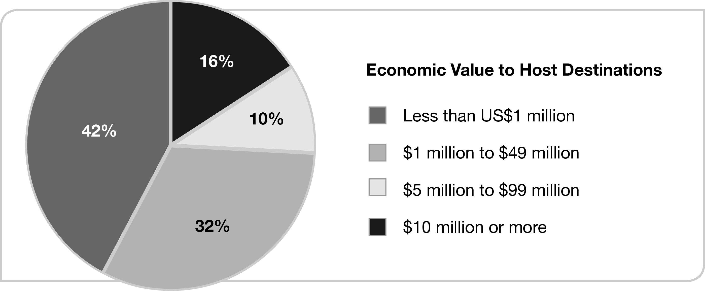
Economic Value to Host Destination

Slide 10
Defining the Service Industry
A sector of the economy that primarily consists of businesses providing services, rather than tangible products.
Includes:
Retail
Transportation
Distribution
Food Services
Health Care
Rentable Facilities

Slide 11
Defining the Hospitality Industry
A sector in the service industry, includes businesses that provide solutions to temporary needs, such a:
Transportation to a destination
Food provision
Venues
Overnight lodging

Slide 12
Meeting Managed by Professionals or Volunteers
Example Titles:
Meetings Coordinator/Planner/Manager
VP of Marketing
Communications Director
Regardless of title, the task is to handle all arrangements for the meeting.

Slide 13
Key Positions for Hire
Independent Planner/Third-party Planner
Professional Congress Organizers (PCOs)
Typically found outside of U.S.
Destination Management Company (DMC)
Destination Management Organization (DMO)
Commonly referred to as CVB

Slide 14
Most Common Meeting Hosts
Association:
Typically use PCOs to conduct their meetings or volunteers.
Corporations
Typically maintain an in-house staff for meeting coordination and travel, but also use independent planners
Government Agencies
Typically use paid public employees and volunteers that can oversee educational meetings and city festivals.

Slide 15
Meetings Served by Multiple Entities
Meetings are held in cities, suburbs, and the wilderness (Destinations)
Once a destination is chosen, the meeting professional must then work with other entities to fulfill the expectations of the meeting.
Venues, Transportation, Caterers, A/V, etc.

Slide 16
Entities Within a Destination
Meeting Facilities
Other Meeting Suppliers
Technology (Audiovisual)
Transportation
Registration and housing
Decorators, Entertainers,
Speakers
Etc., depending on the capacity of the event

Slide 17
Meetings Guided by Stakeholders

Slide 18
Meetings Guided by Stakeholders

